Slide 1

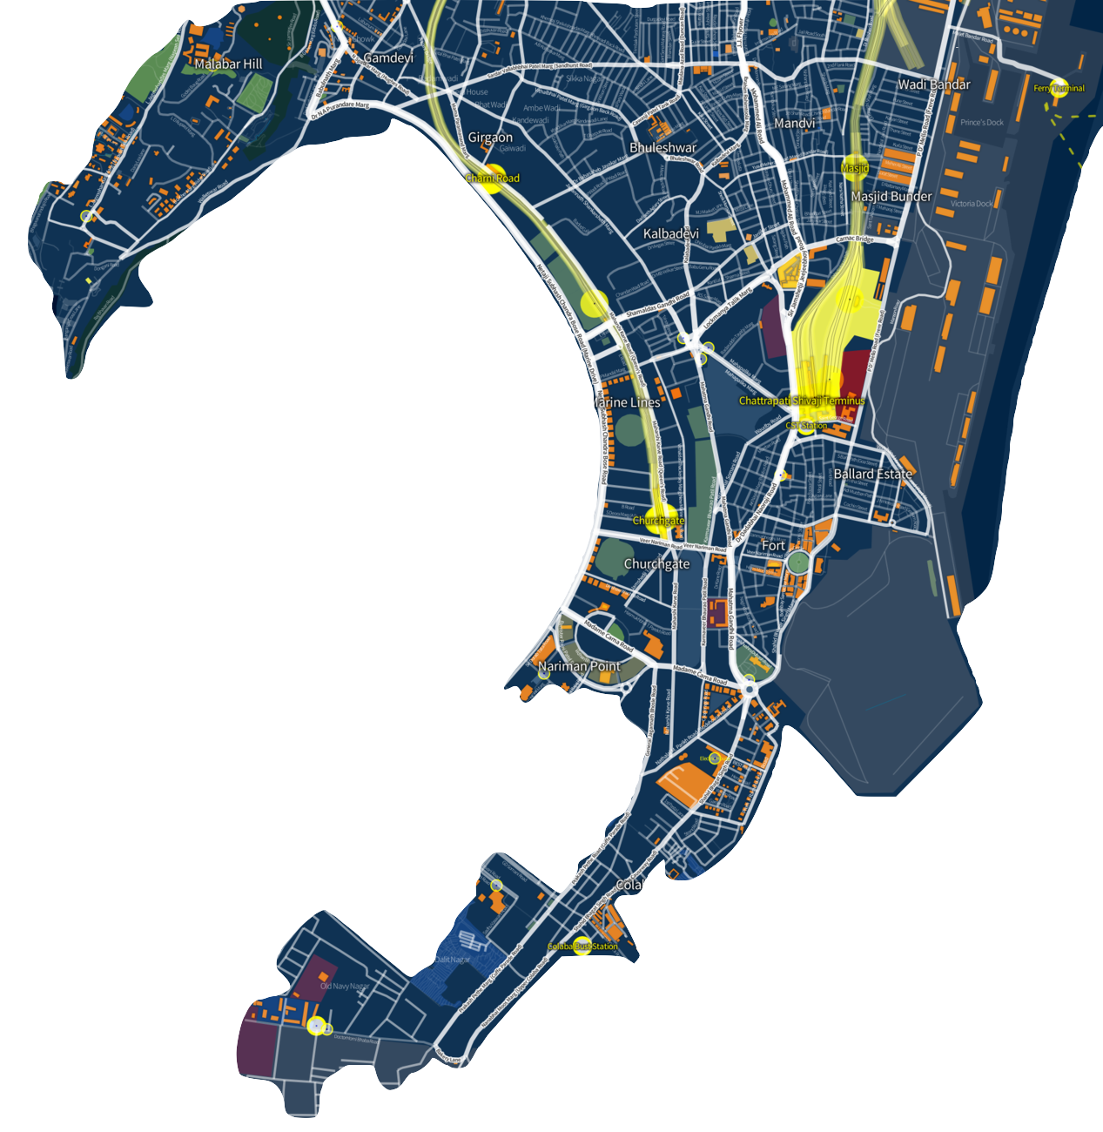

GEO PROFILING OF ROUTES
Travel Safe
Worli
Kurla
Busy and safe neighbourhood.
High Crime prone area. Route must be diverted to a busy and safer route..
Marine Lines
Busy commute .
Colaba
Safe Neighbourhood

Slide 2
GEO PROFILING OF ROUTES
Travel Safe
Organization Name : Ericsson
Problem Statement : Geographical
Profiling of Routes
and Surveillance
Team Name : Pepehands
Team Leader Name : Harshit Rai
AICTE Code : 1-3508354456
Notes:
© Copyright Showeet.com – Creative & Free PowerPoint Templates

Slide 3

GEO PROFILING OF ROUTES
Travel Safe
IDEA DESCRIPTION
Travelers use applications like Google Maps on a large scale to get assistance in deciding their routes.
Often these passengers unknowingly select routes which pose potential threats to their security.
The current routing options offered by services like Google Maps do not consider various security parameters.
“Travel Safe (TS)” is an AI-enabled mobile application which aims to make road travel safer than ever.
TS will give the highest priority to the travelers’ safety by classifying routes into several categories like Safe, Moderately Unsafe, Extremely Unsafe, etc.
This application will introduce “Safety Scale” for precise and detailed classification of routes.
Safety Scale

Slide 4





GEO PROFILING OF ROUTES
Travel Safe
7. The classification of routes will be done on the basis of region-specific
crime data obtained from the local authorities
8. Besides crime data, the safeness of a region also depends on a
number of other factors like population density, average income in
the region, number of surveillance cameras, etc.
9. Every region will be assigned a safety rating which will be then
mapped onto the “Safety Scale”.
10. The safety ratings for every region will be generated by an ML
(Machine Learning)-based prediction model.
11. Lower the value of safety rating for a region on the safety scale, more
unsafe will be the area for travelers.
12. Once all the feasible routes from the source to the destination are
identified, the most secure route will be recommended to the user.
13. If the user selects a potentially unsafe route by going against the
recommendations, the emergency contacts will be notified about the
same as a measure of security.
TECHNOLOGY STACK
Java : For developing the Android application.
Android SDK : For developing the Android Application.
TensorFlow : For training ML-based models.
Amazon Web Services : For hosting the backend of the application.
Python : For hosting the backend of the application.

Slide 5



GEO PROFILING OF ROUTES
Travel Safe
USE CASE
Can be used by individuals as an essential tool which helps them travel safely.
Can be used by Emergency Services in case of adverse situations.
Can be used to decide the travel routes of VIPs to prevent any mishaps.
SHOW STOPPERS
Smart ‘Safety Scale’ for precise and detailed classification of routes.
Estimation of safety levels in regions, with little or no historical data, with the help of machine learning.
Alerts to selected contacts in case of emergency situations.
Extremely Unsafe
Extremely Safe

